Slide 1
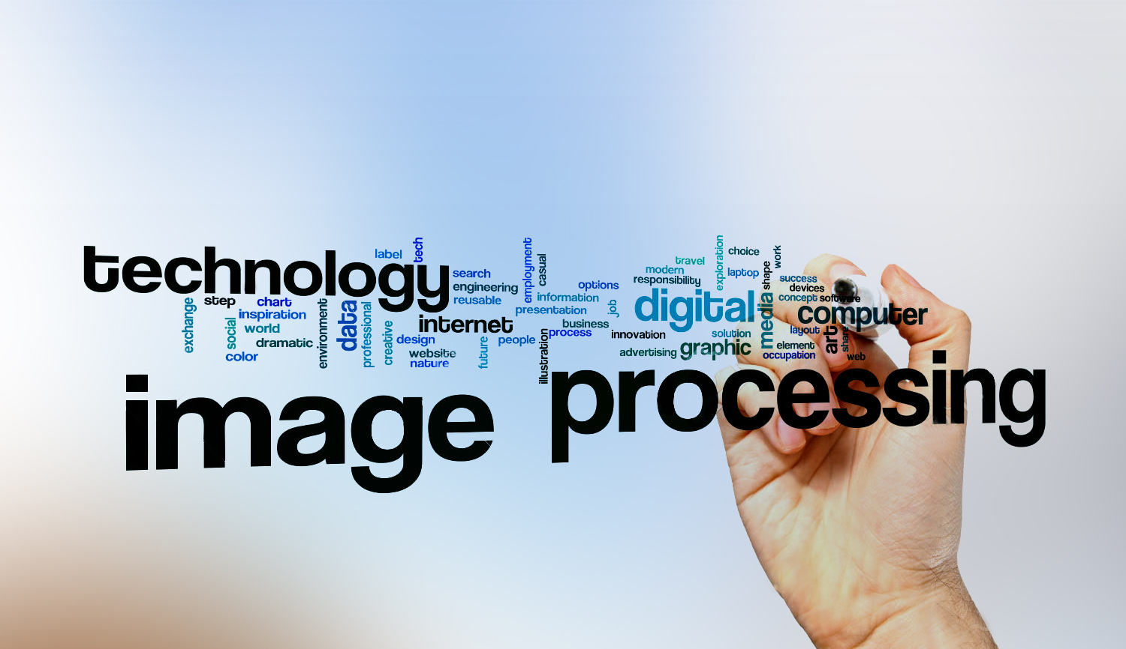
Digital Image Processing
3- DIP apps ?

Slide 2
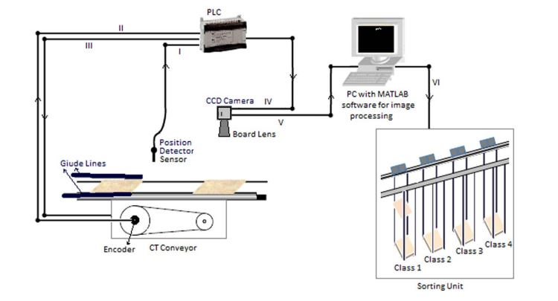
Digital Image Processing
3- DIP apps ?
1) Industrial machine
detection for ceramic

Slide 3
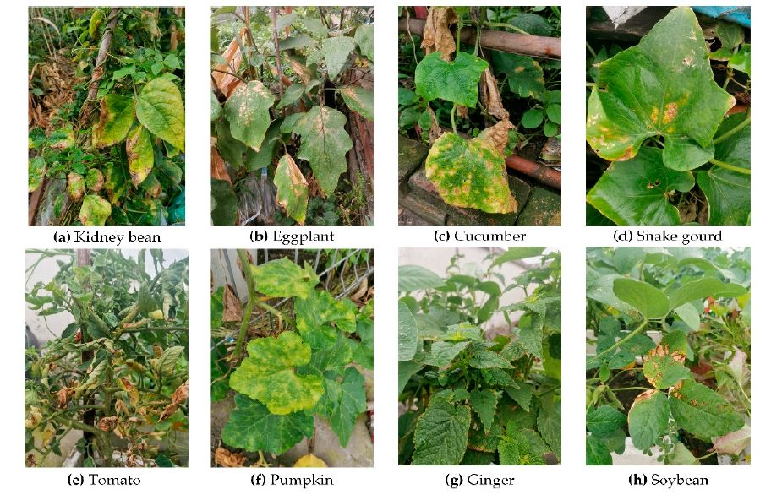
Digital Image Processing
3- DIP apps ?
2) Plant leaf disease classification.
Leaf has infectious or not.

Slide 4
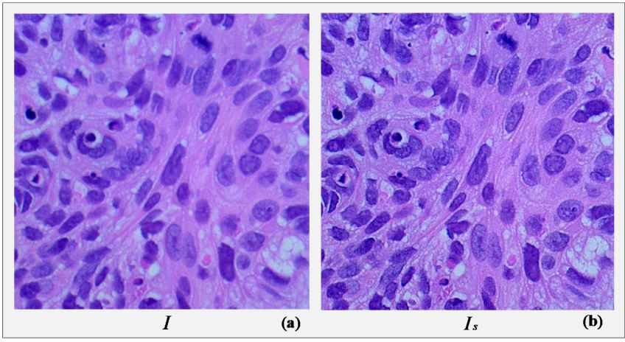
Digital Image Processing
3- DIP apps ?
3) cancer classification using CNN
In this application,
we use image sharpening.

Slide 5
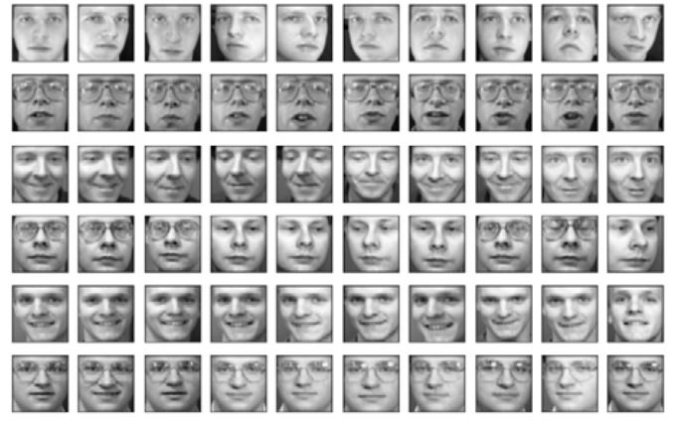
Digital Image Processing
3- DIP apps ?
4) Face recognition
The first step is image detection then we use extracted features for recognition

Slide 6
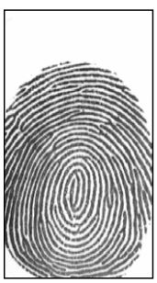
Digital Image Processing
3- DIP apps ?
5) Fingerprint recognition
We use image enhancement in this application to make images more clear

